Slide 1
Open MPI
Borosu Cristina-Ana
Luca Alexandra-Adela

Slide 2
Message Passing Interface (MPI)
Library specification for message-passing
Written and ratified by the MPI Forum - academic, research, industry representatives
Programming languages such as Fortran, C, C++ and Java
Specifications: MPI-1 (1994), MPI-2(1996), MPI-3 (2012)

Slide 3
Message Passing Interface (MPI)
De facto standard for communication among processes that model a parallel program running on a distributed memory system
Dominant model used in high-performance computing today
Provides essential virtual topology and communication functionality between a set of processes

Slide 4
Message Passing Interface (MPI)
Typically, for maximum performance, each CPU (or core in a multi-core machine) will be assigned just a single process
This assignment happens at runtime through the agent that starts the MPI program, normally called mpiexec

Slide 5
MPI Library Functions
Point-to-point send/receive operations
Exchanging data between process pairs
Combining partial results of computations
Obtaining network-related information
number of processes in the computing session
current processor identity that a process is mapped to
neighboring processes accessible in a logical topology

Slide 6
MPI Implementations
Vendors
- HP MPI, Intel MPI, Scali MPI
Open source
- Open MPI, MPICH[2]
Research
- Proof-of-concept
- Not usually for production usage

Slide 7
Open MPI
Open source MPI implementation
Developed and maintained by a consortium of academic, research, and industry partners
Middleware – between the application and the network
Simplifies network activity to the application
Replaces several prior MPI implementations

Slide 8

Open MPI

Slide 9
Open MPI Advantages
High performance
Low latency
- High bandwidth
Abstracts the network
- Application calls MPI_SEND/MPI_RECV
- Connections are made automatically

Slide 10
Open MPI
Used by many TOP500 supercomputers
Sun switched to Open MPI from its own implementation of MPI - Sun HPC ClusterTools

Slide 11
Modular Component Architecture (MCA)
Framework: functionality specification
Component (plugin): implementation for a specific functionality
Module: instance of a component

Slide 12
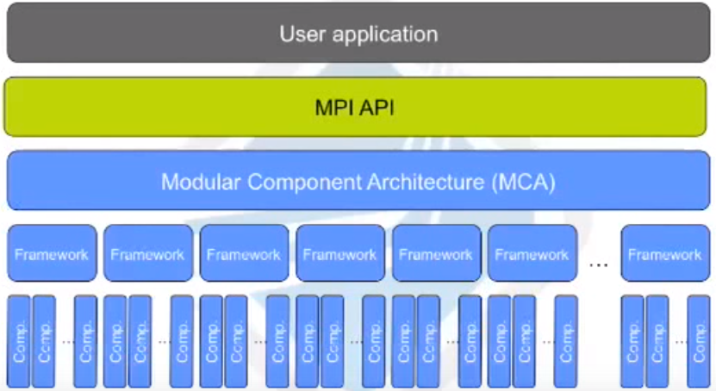
Modular Component Architecture (MCA)

Slide 13
Open MPI Code Sections
OMPI - Open MPI
- The MPI API and supporting logic
ORTE - Open Run-Time Environment
- Support for different back-end run-time systems
OPAL - Open Portable Access Layer
- utility code used by OMPI and ORTE

Slide 14
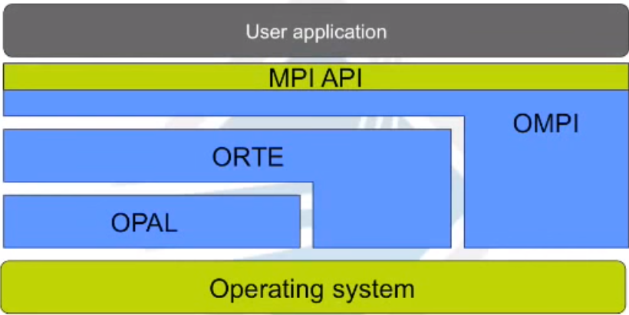
Open MPI Code Sections

Slide 15
MCA Parameters
Runtime tunable values
- per layer
- per framework
- per component
Change behavior of code at runtime
- e.g. choose network protocol for communication

Slide 16
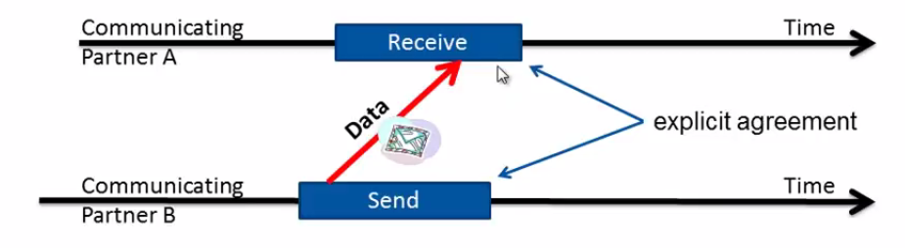
Open MPI
Explicit sending data

Slide 17
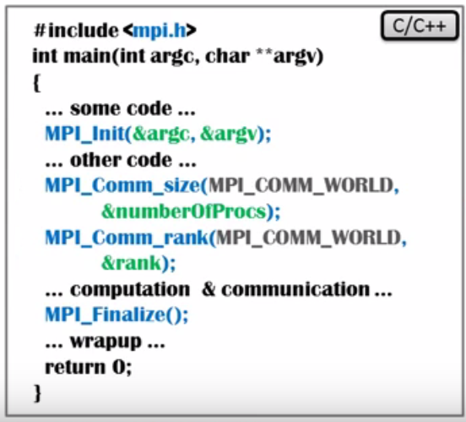

Slide 18
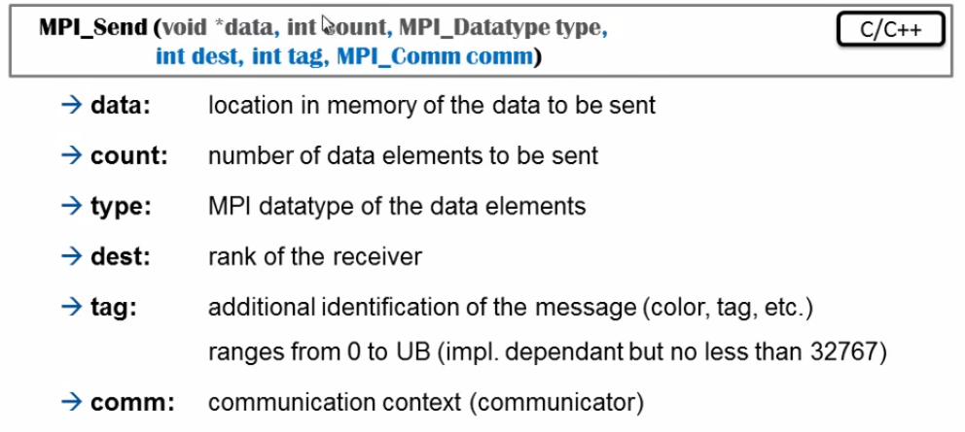

Slide 19
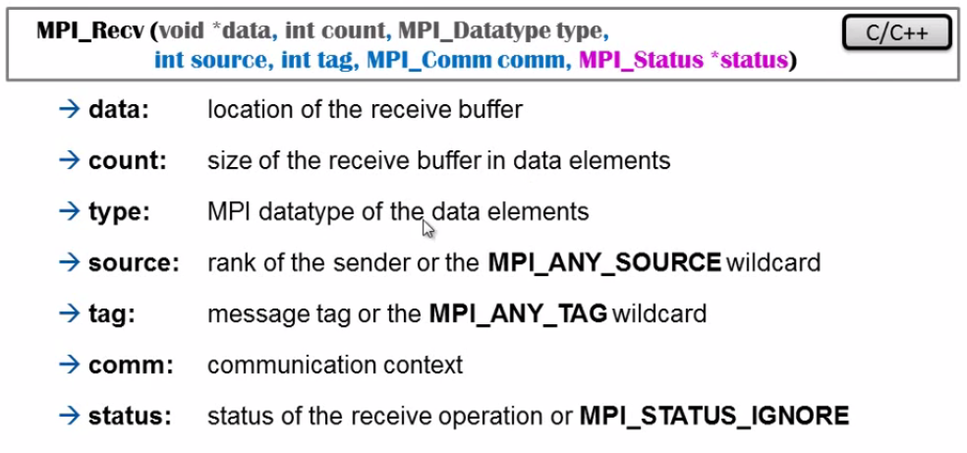

Slide 20
Bibliography
https://en.wikipedia.org/wiki/Open_MPI
https://en.wikipedia.org/wiki/Message_Passing_Interface
https://www.open-mpi.org/
https://github.com/open-mpi/ompi/tree/master/examples

